Slide 1
Recognizing ASL with AI
David Umanzor
Polk State College

Slide 2
Overview
Motivation
Model
Results
Conclusion
Takeaways
Acknowledgements
Future Projects

Slide 3
Motivation
My motivation is to help and increase inclusiveness in technology.
Technology has many uses and joys that people get to experience but there are people who do not have access or the ability to use some technologies.
Learning experience in image processing.
“If voice is the future of computing what about those who cannot speak or hear?” – Abhishek Singh
Notes:
A buh shek sing
Who developed a deep learning program to translate American sign language to Alexa

Slide 4
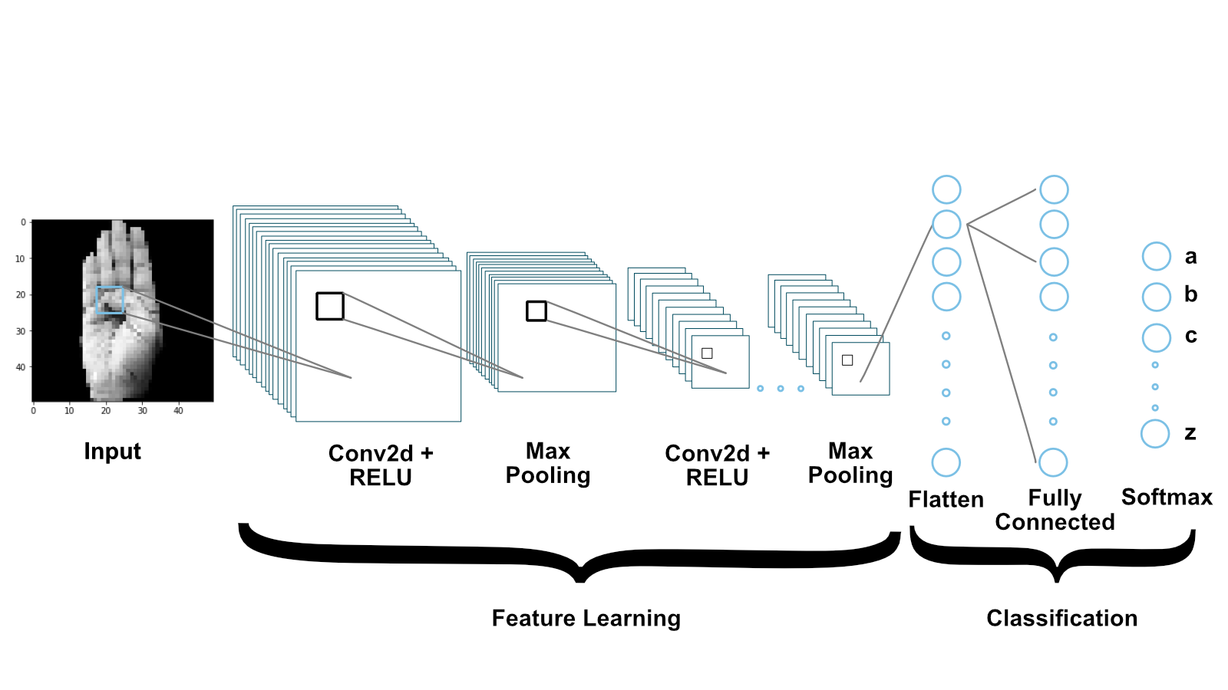
Model
The model we use to train the AI is a Convolutional Neural Network (CNN), This model shows the CNN that we used to train the AI. The CNN takes pictures and breaks them down into smaller segments called features. It is trained to find patterns in features over the images allowing the CNN to predict an 'a', 'b', or 'c’ based on the similarities in the image.
Notes:
This model shows the CNN model that we used to train the AI. The CNN takes pictures as a input and breaks them down into smaller segments called features. It is trained to find patterns in features over the images allowing the CNN to predict an 'a', 'b', or ‘c’ based on the similarities in the image.

Slide 5
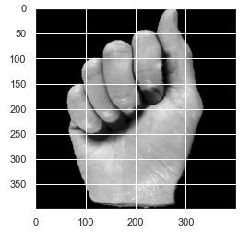
Model
For the model we used a dataset of 282 hands for the letters ‘a’, ‘b’, and ‘c’ to train the model. We use two sources of datasets, the first is from kaggle which it was already prepared but we needed more.
The second is a self-made dataset by taking images and cropping it to the same size as the first dataset at 400 by 400 pixels focused on the hand.
The program then sets the images to grayscale as the color is not needed for this research. Finally, the images are reduced to various resolutions for the AI to use for training.
Notes:
Figure 2: Hand from the dataset of the letter ‘b’

Slide 6
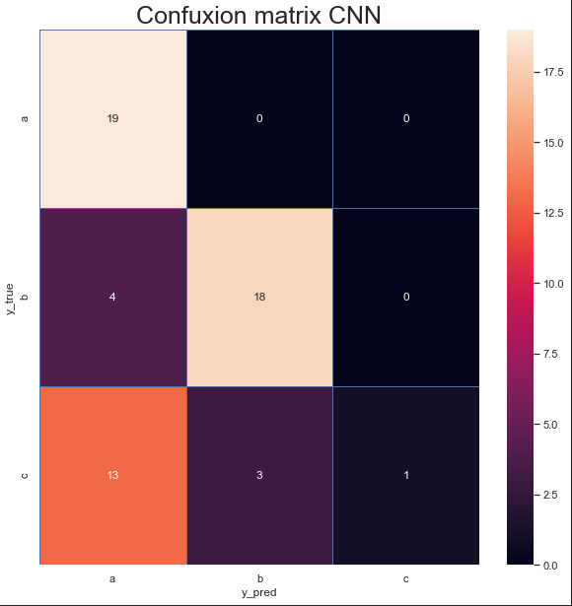
Results
s
Our model gave us a 66% accuracy overall with class ‘c’ being the lowest scored label.
The results showed that class ‘a’ had an accuracy of 100%, class ‘b’ had an accuracy of 82%, and class ‘c’ had an accuracy of 6%.
Notes:
Class ‘c’: 6%
Class ‘b’: 82%
Class ‘a’: 100%
Figure 3: The Confusion Matrix of the CNN model

Slide 7
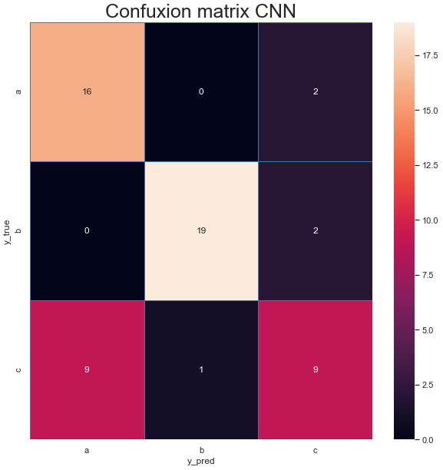
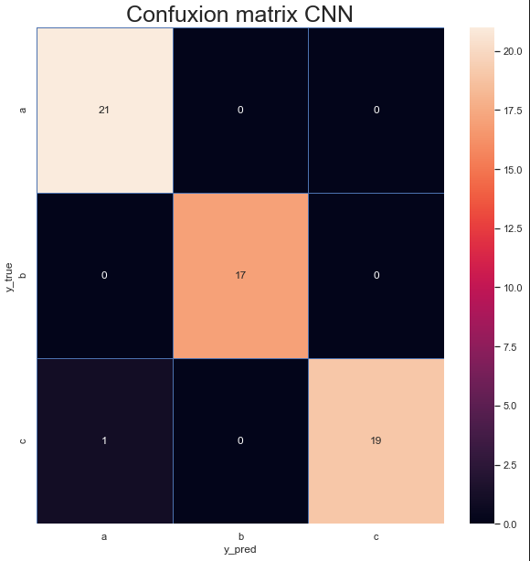
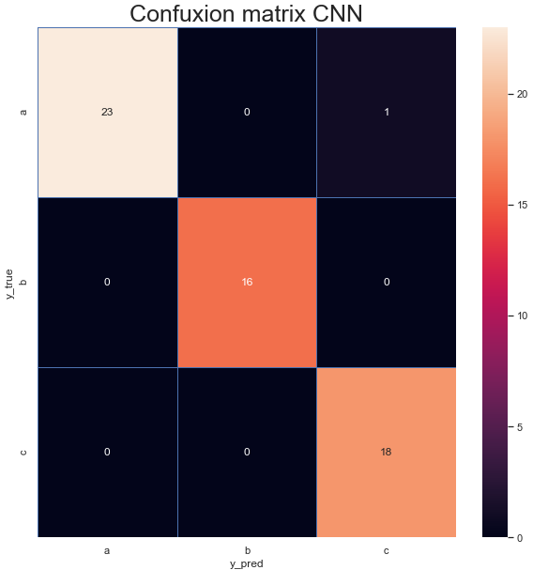
Results
s
s
s
s
50x50
80x80
100x100
200x200
Notes:
Looking at the confusion matrix we can see the influence the resolution has over the images as starting with the first matrix at a resolution of 50 by 50 the model has only 1 correct, increasing the resolution to 80 by 80 then leads to a 47% accuracy, the model then jumps to a 98% for the 100 by 100 and 200 by 200. You can visually see this as the confusion matrix creates a diagonal line matching predictions with the correct answer.

Slide 8
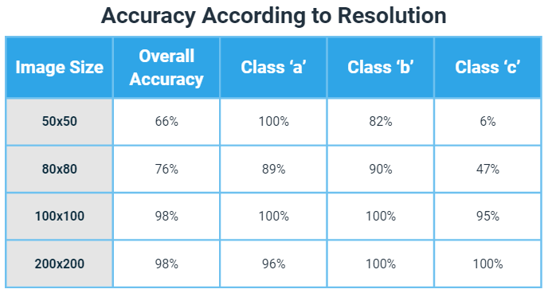
Results
Because we had a low accuracy for the first model, we checked the accuracy of the program at different resolution levels.
As the resolution increased the accuracy increased until at image size of 100 by 100 it plateau at 98%
Notes:
Figure 4: Accuracy of each model based on Image Size

Slide 9
Conclusions
From the given results, the letters 'a' and 'c' became the most difficult for the CNN to differentiate from each other, as shown in the confusion matrix.
We suggest that the low accuracy rate in the first model is based on the low resolution and the lack of a larger dataset for the AI to learn from.
Using a larger resolution improved the accuracy of the AI the most when the image is 1/4th of the images original size due to the fact the AI was able to find similarities between the hands in the same class.
In the future we could use a larger dataset to improve the AI to be more accurate.

Slide 10
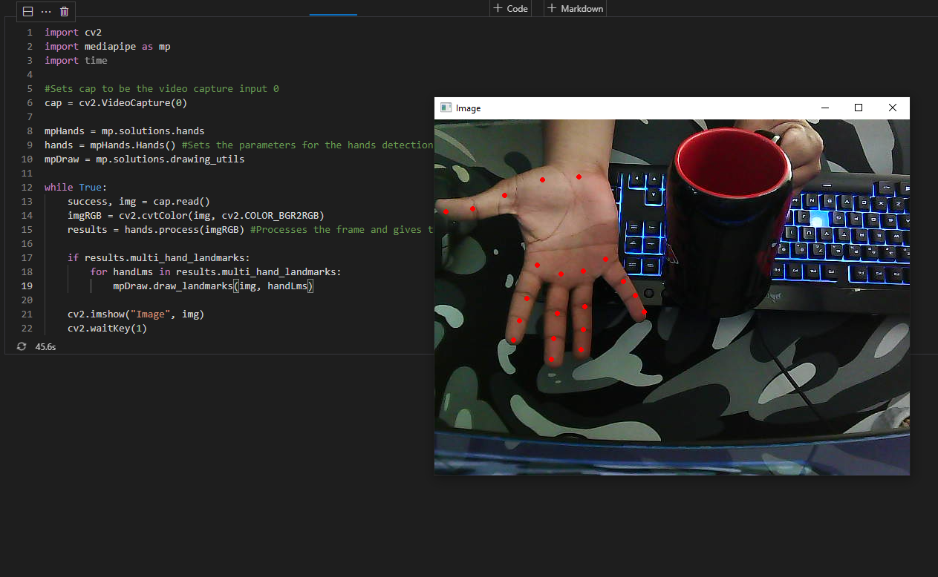
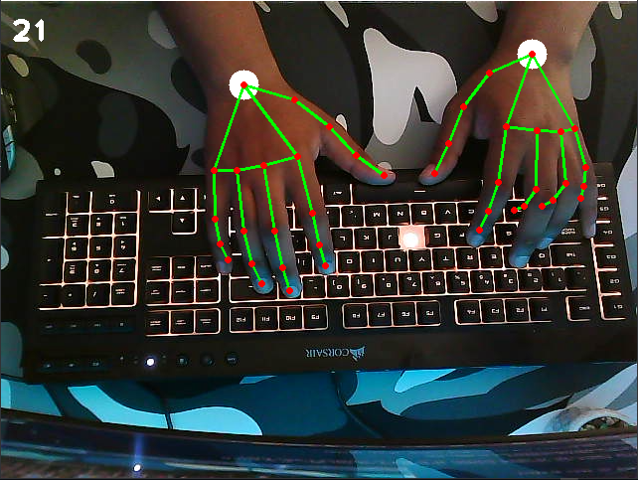
Future Projects
Notes:
Some projects I would like to move towards working on is changing from still image to live recognition and processing. Like the person I gained inspiration from I would like to build a program to allow voice activated system be used without a voice.

Slide 11
Takeaways from REU Experience
During this experience I’ve been able to build bonds with my peers and mentors and grasp a better understanding of AI and the process of research.
With this I’ll be able to properly document and format research of my own that I wouldn’t have been able to before.
This has been a great way I can grow and gain the resources needed to conduct projects and personal research.

Slide 12
Acknowledgments
We thank Carlos Theran (Florida A & M University) for advising, guidance, and resources used in the research; We thank Yohn Jairo (Florida A & M University) for guidance and aid on the research report; We thank Gregor von Laszewski (Florida A & M University) for advice and commenting on the code and report; We thank the Byron Greene and Polk State LSAMP Program for aid in obtaining this opportunity. We thank Florida A & M University for funding this research.
Notes:
Theran ( Ther-an )
Jairo (Hairo) Parra Bautista
Laszewski (Luh-Sheef-ski)

